Slide 1
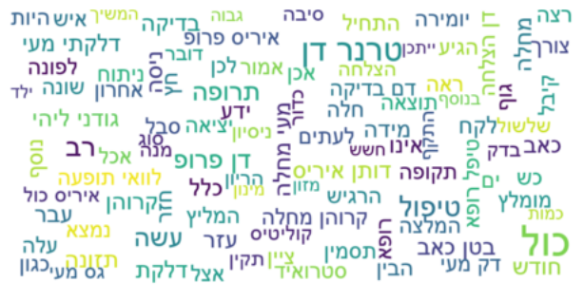
Charactering Diseases
in “Camoni” Website
Roei Shlezinger and Ido Margaliot
Workshop in Hebrew NLP

Slide 2
Background
"Camoni" is a site that contains forums for people dealing with diseases. The forums are referred to as communities.
The communities serve as support and consultation groups for people in the same situation and with medical experts.

Slide 3

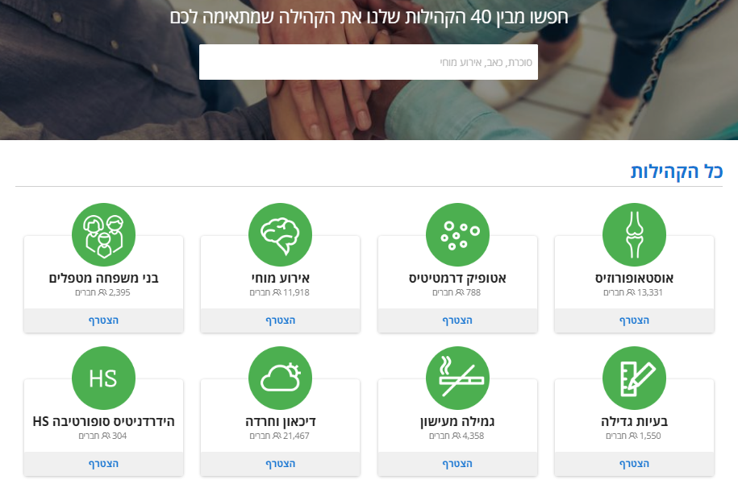
Data

Slide 4
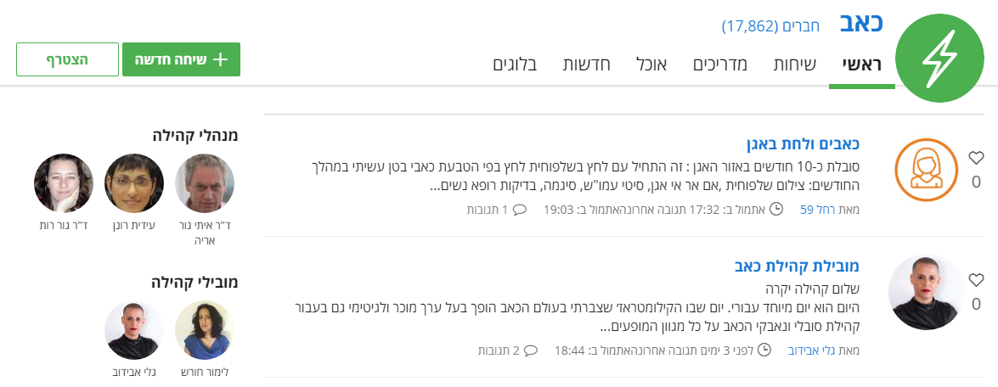
Data

Slide 5
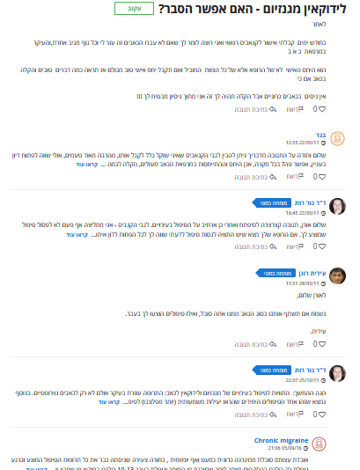

Slide 6
Special Chronic Diseases
Diseases with wide range of symptoms, dynamics of flare and relaxation, with possible connections to different factors, which are not known yet in the medical literature.

Slide 7
Research Goal
We set out to find in these diseases connections between different factors, symptoms and treatments, and diseases progression.
Notes:
הקשר בין גורמים סימפטומים וטיפולים שונים

Slide 8
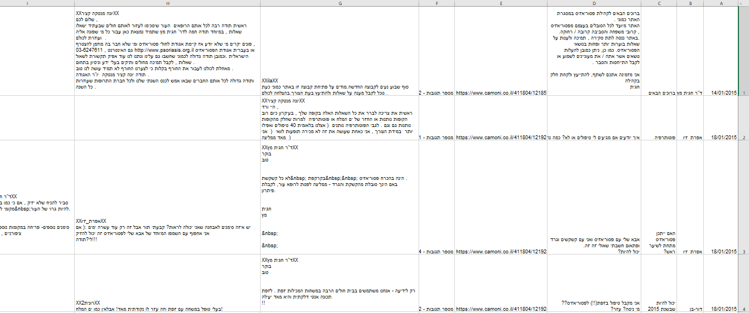
Data
we got 5 communities:
Pain
Crohn and Cololitis
Joints
Psoriasis
Multiple Sclerosis

Slide 9
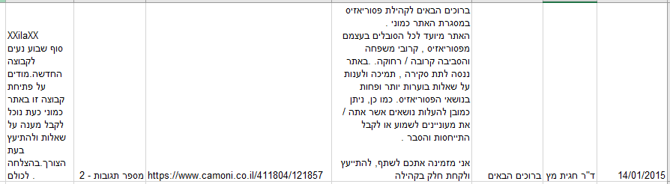
Data

Slide 10
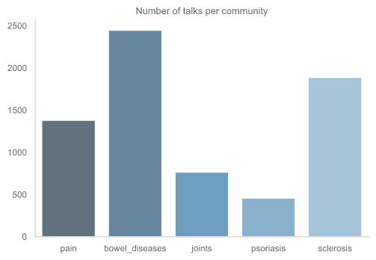
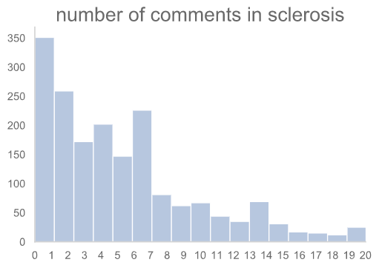
Brief overview on the data

Slide 11
Pipeline
Clean data
  Extract writer names
  Remove HTML tags
  Remove signs, phone numbers, websites etc.
Run YAP and save lemmas
Topic analysis of all 5 communities
  Remove punctuation, writes names and stop words in this data
  Apply logistic regression using Tfidf transformer
  Find model’s most weighted words in each community

Slide 12
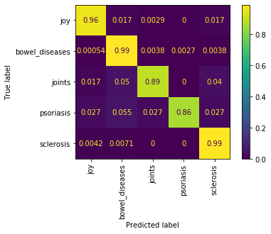
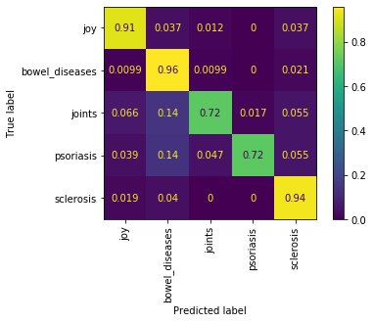
Normalized Confusion Matrices
for Logistic Regression
Training Set Test Set
precision: 0.97
recall: 0.94
F1 score: 0.95
precision: 0.91
recall: 0.85
F1 score: 0.88

Slide 13
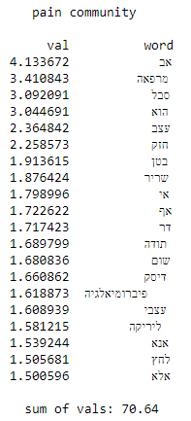
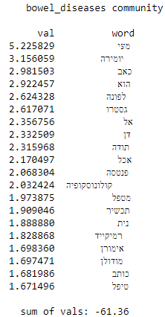
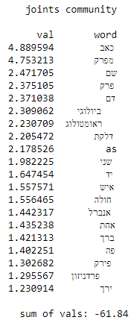
20 Most Weighted Words
per Community

Slide 14
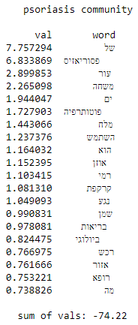
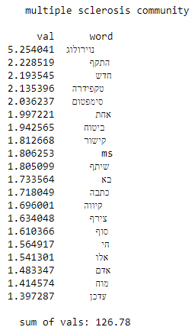
20 Most Weighted Words
per Community

Slide 15
Summary
In the presentation we presented the "Camoni" site.
We showed how we cleaned our database.
We adapted an initial model, which identifies the characteristic words of each database.
The high accuracy of our results reinforces the hypothesis that our database contains useful information.

Slide 16
Further work
If we had more time and staff, we would apply more complex tools for cleaning and organizing the text, and models that analyse whole sentences.
Then create lists of factors, symptoms and treatments and try to extract features from each response, tagged by names.
Once we had the features we would try to fit a model like Markov chain and produce a model that describes the dynamic evolution of the disease.

Slide 17
Thank you,
and we will be happy to take questions.

